Slide 1
Intro to Python
Module 01
Data Science Developer

Slide 2
Why Should You Learn to Code?

Slide 3
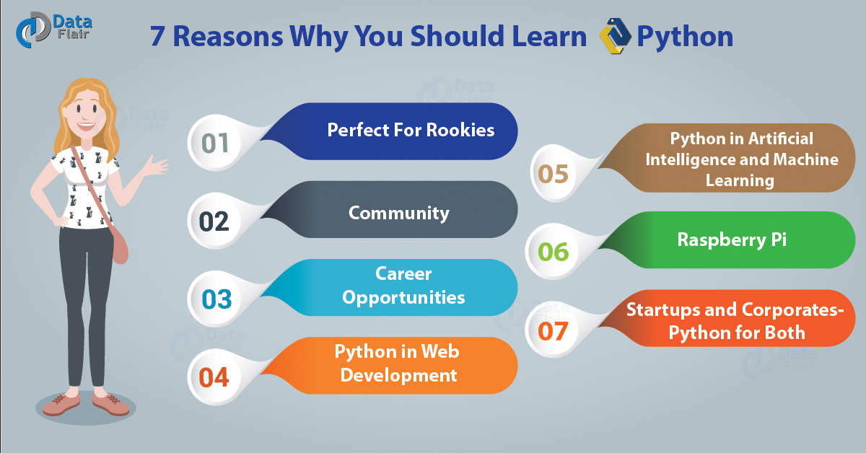
Why Should You Learn Python?

Slide 4
Top Code Editor 2017
https://risingstars.js.org/2017/en/

Slide 5
Python
Python is an interpreted high-level programming language for general-purpose programming.

Slide 6

SetUp
Visual Studio Code
Download & install here:
code.visualstudio.com
Anaconda
Download & install here:
https://www.anaconda.com/download/

Slide 7
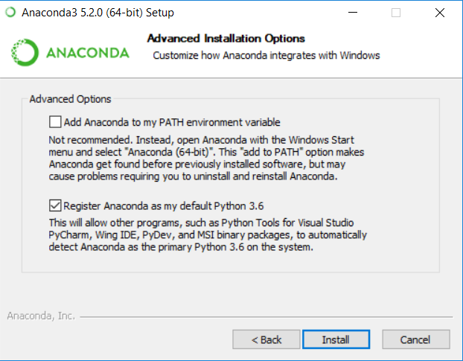
Anaconda SetUp
Ikuti setting defaultnya, jangan langsung add Path env variablenya

Slide 8
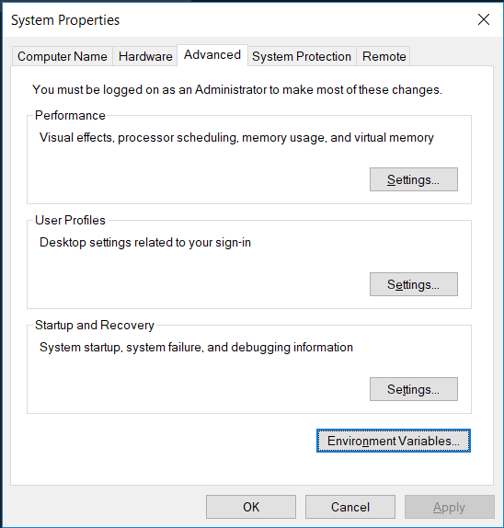
Anaconda SetUp
Search Environment Variables di windows, akan kebuka window seperti itu

Slide 9
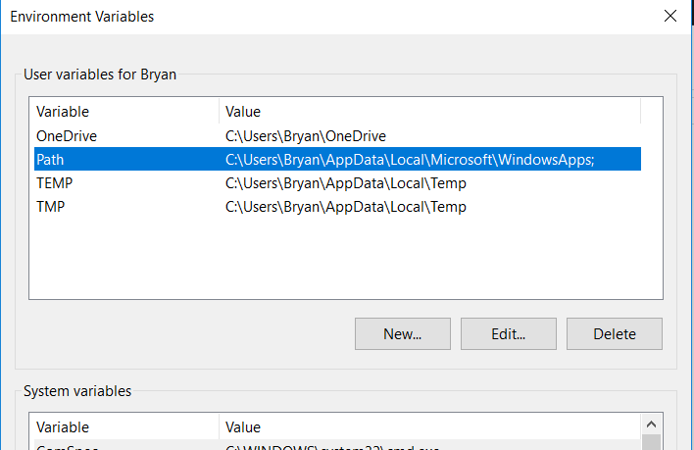
Anaconda SetUp
Pilih Path, terus klik button Edit

Slide 10
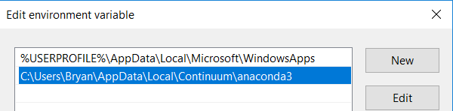
Anaconda SetUp
Kemudian tambahkan path baru ke folder dimana Anaconda kalian diinstall

Slide 11
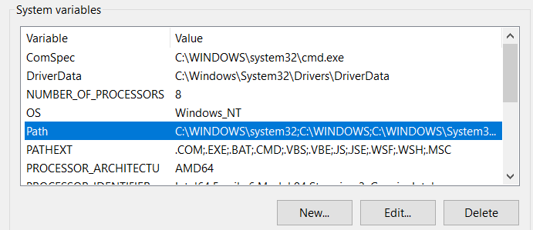
Anaconda SetUp
Sekarang pilih Path dibagian System variables dan klik button Edit

Slide 12
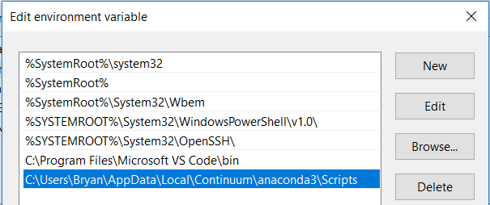
Anaconda SetUp
Kemudian tambahkan path baru ke folder anaconda3/Scripts kalian

Slide 13
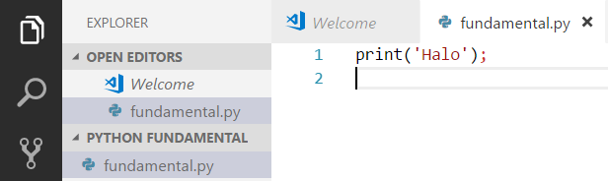
Make your first py file
Ketik print('Halo');
Lalu jalankan di terminal VS Code dengan mengetik python fundamental.py (nama filenya)

Slide 14

Comment
Pilih baris2 yang mau dicomment dan tinggal pencet
Ctrl + /

Slide 15
Variabel
Variables are named values and
can store any type of value.

Slide 16
Variabel
nama = 'Andi';
print(nama);
usia = 22;
usia = 32;
print(usia);
jomblo = True;
print(jomblo);

Slide 17
Data Type
nama = 'Andi';
usia = 22;
jomblo = True;
print(type(nama));
print(type(usia));
print(type(jomblo));

Slide 18
Input
nama = input("Whats your name? : ");
print(nama);

Slide 19
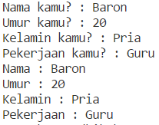
Solved It!
Buatlah apps minta 4 input tersebut dan print inputnya dengan format seperti itu

Slide 20
Solved!
nama = input("Nama kamu? : ");
umur = input("Umur kamu? : ");
kelamin = input("Kelamin kamu? : ");
pekerjaan = input("Pekerjaan kamu? : ");
print("Nama : " + nama);
print("Umur : " + umur);
print("Kelamin : " + kelamin);
print("Pekerjaan : " + pekerjaan);

Slide 21
Numbers & Arithmetic Operators
usiaAndi = 40;
usiaBudi = 20;
print(usiaAndi * usiaBudi);
print(usiaAndi / usiaBudi);
print(usiaAndi + usiaBudi);
print(usiaAndi - usiaBudi);
print(usiaAndi % usiaBudi);
print(usiaBudi ** 2);

Slide 22
Numbers & Arithmetic Operators
usiaAndi = 40;
usiaBudi = 20;
usiaAndi += 3;
# usiaAndi = usiaAndi + 3;
usiaBudi *= 4;
# usiaBudi = usiaBudi * 3;
print(usiaAndi);
print(usiaBudi);

Slide 23
Math Module
import math
print(math.pi);
print(math.fabs(-4.7));
print(math.pow(8, 2));
print(math.sqrt(64));

Slide 24
Round, Ceil, & Floor
import math
print(round(4.7));
print(round(4.4));
print(math.floor(4.7));
print(math.ceil(4.4));

Slide 25
Strings
x = 'Halo Dunia';
print(len(x));
print(x.index('Dunia'));
print(x.split(' '));
print(x.lower());
print(x.upper());
print(x.capitalize());

Slide 26
Strings
singleQuotes = 'single quotes';
doubleQuotes = "double quotes";
combineQuotes = "wrap lot's of other quotes"
print(singleQuotes);
print(doubleQuotes);
print(combineQuotes);

Slide 27
Strings Indexing
text = "I'm Baron, nice to meet you";
print(text[1]);
print(text[2:]);
print(text[:4]);
print(text[2:5]);
print(text[:]);

Slide 28
Convert Strings to Numbers
angka1 = input("Masukkan Angka 1 : ");
angka2 = input("Masukkan Angka 2 : ");
print(angka1 + angka2);
print(int(angka1) + int(angka2));
angka1 = float(angka1);
angka2 = float(angka2);
print(angka1 + angka2);

Slide 29
Adding Strings & Numbers
usia = 22;
nama = 'Andi';
print(usia + usia);
print(nama + ' ' + nama);
print(nama + ' ' + str(usia));

Slide 30
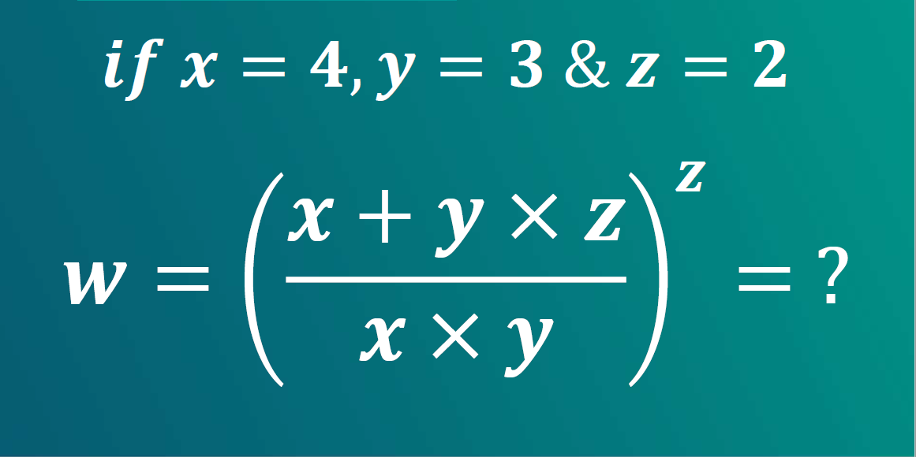
Solve It! #1

Slide 31

Solve It! #2

Slide 32
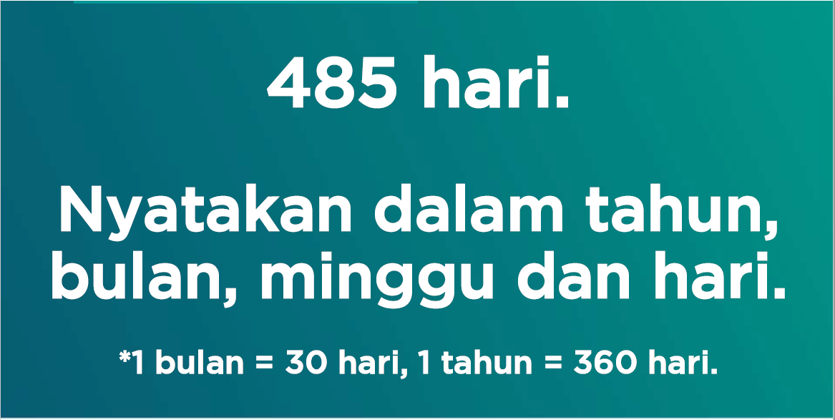
Solve It! #3

Slide 33
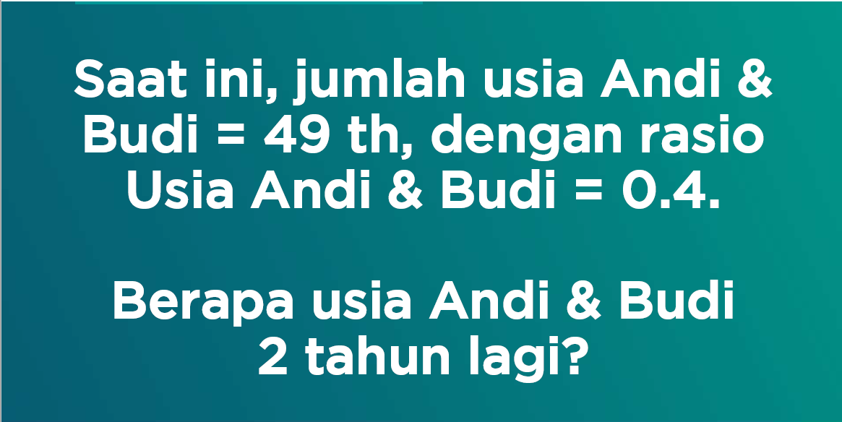
Solve It! #4

Slide 34
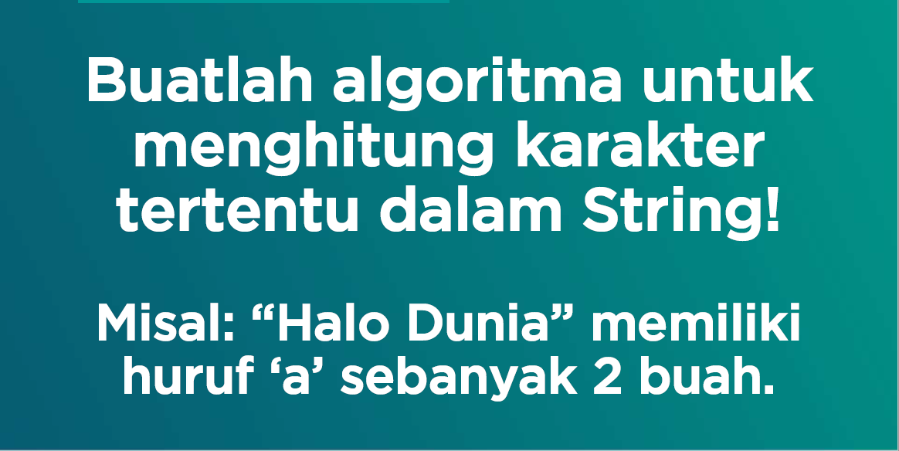
Solve It! #5

Slide 35
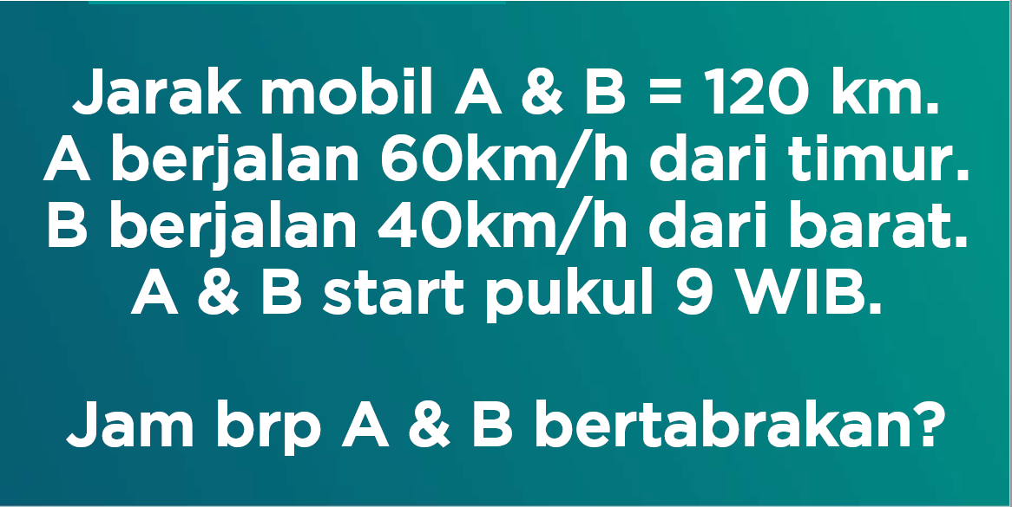
Solve It! #6

